Slide 1



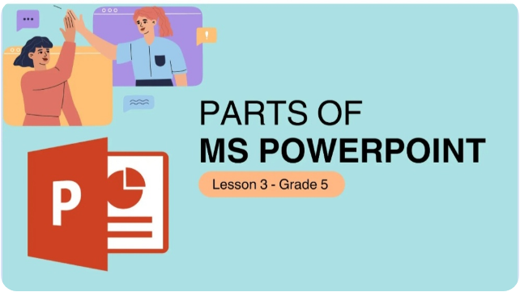
PARTS OF MS POWERPOINT

Slide 2

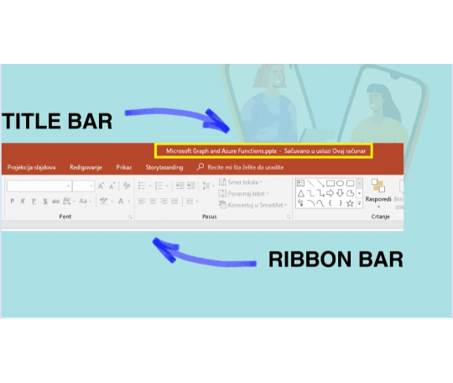

Title Bar & Ribbon Bar
Key Components
Title Bar: Displays the name of the active presentation file along with the program name.
Ribbon Bar: Contains tabs organized into groups of commands to help you quickly design and edit slides.

Slide 3
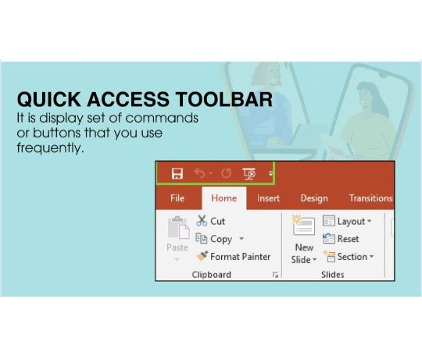

Quick Access Toolbar
Fast Commands
It is a customizable display set of commands or buttons that you use most frequently, such as Save, Undo, and Redo.

Slide 4
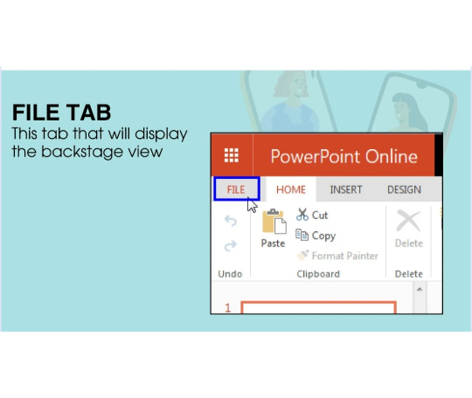
File Tab
Backstage View
Clicking the File Tab opens the Backstage view where you can manage files: opening, saving, printing, sharing, and changing options.

Slide 5
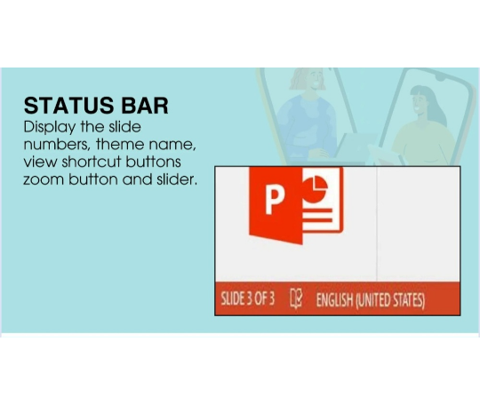

Status Bar
Slide Information
Located at the bottom of the window, the Status Bar displays key details such as:
Slide number and total count
Theme name & language
View shortcut buttons
Zoom slider and button

Slide 6
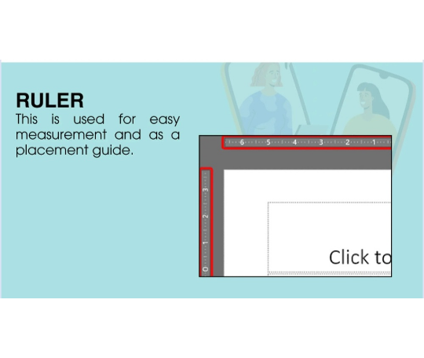
Ruler
Precision & Alignment
The horizontal and vertical rulers are used for easy measurement and serve as accurate placement guides for text boxes and shapes on your slide.

Slide 7
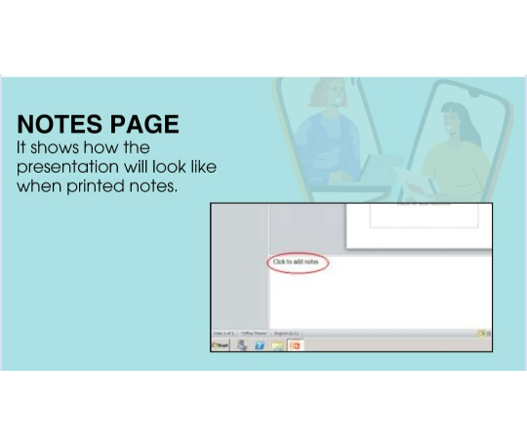
Notes Page View
Speaker Notes
It shows how the presentation will look when printed with speaker notes included below each individual slide.

Slide 8
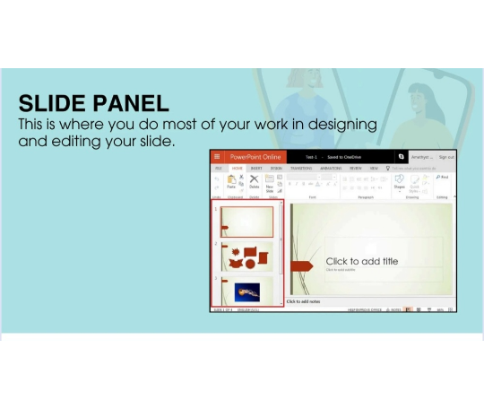
Slide Panel
Main Workspace
This is the central area where you perform most of your creative work — inserting text, designing visuals, adding graphics, and editing slide elements.

Slide 9
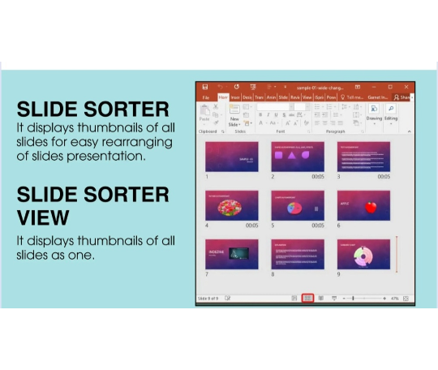
Slide Sorter View
Thumbnail Overview
Displays small thumbnails of all slides in grid format for effortless reordering, organizing, and managing transition effects across your presentation.

Slide 10
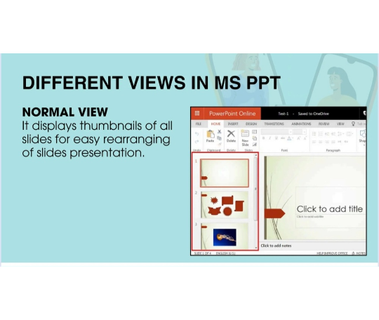
Different Views: Normal View
Standard View Mode
Normal View is the default editing mode, providing a slide navigation pane on the left alongside the main slide editing area on the right.

Slide 11
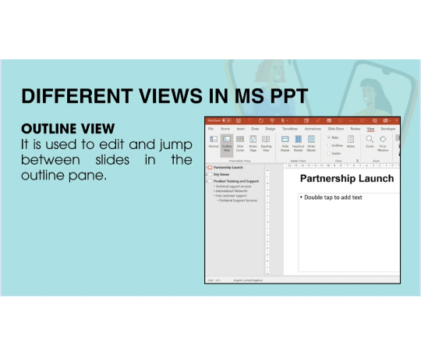

Different Views: Outline View
Outline Structure
It is used to edit text and quickly jump between slides in the outline pane on the left side of your window.

Slide 12
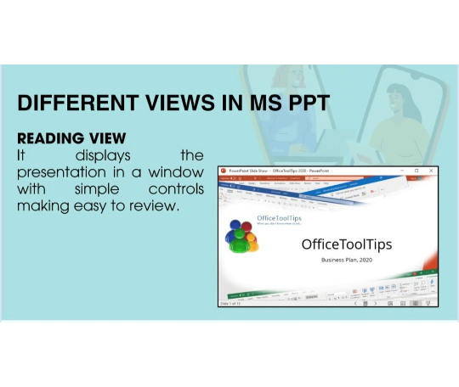
Different Views: Reading View
Review & Read Mode
It displays the presentation in a full-window format with simple controls, making it easy to review without starting a full slide show.

Slide 13

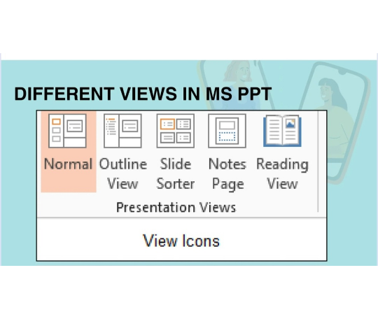
Different Views in MS PPT
View Icons
Easily switch between standard modes using the View tab or status bar shortcuts:
Normal View: Default design mode
Outline View: Text structure pane
Slide Sorter: Thumbnail grid
Notes Page: Print layout with notes
Reading View: Windowed slide review

Slide 14
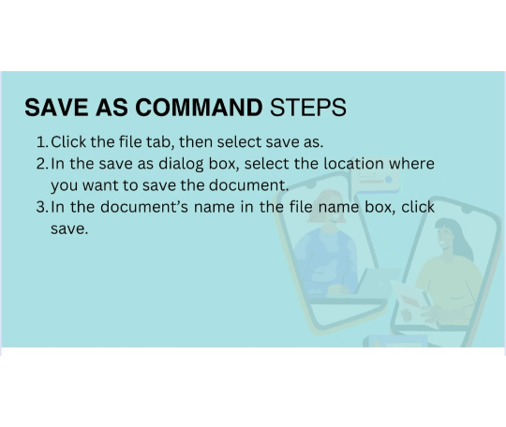

Save As Command Steps
Saving Your Work
1.
Click the File tab, then select Save As.
2.
In the Save As dialog box, select the location where you want to save the document.
3.
Enter the document's name in the file name box, then click Save.

Slide 15
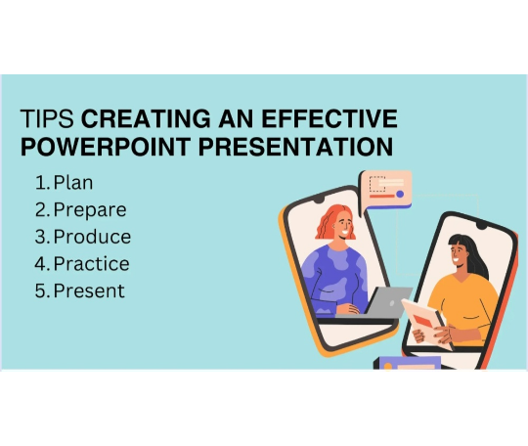

Tips for Effective Presentations
The 5 P's of Success
1.
Plan: Define your goals and audience.
2.
Prepare: Gather content & structure ideas.
3.
Produce: Design clean and engaging slides.
4.
Practice: Rehearse your delivery.
5.
Present: Deliver with confidence!

Slide 16

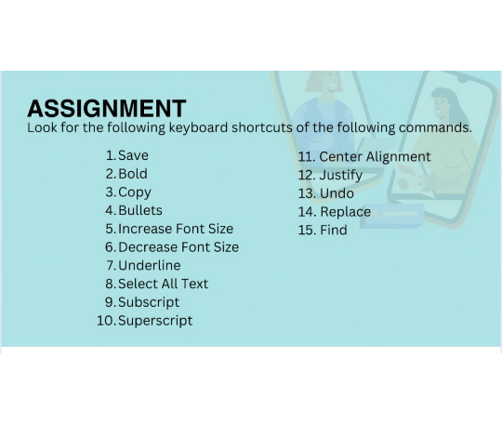
Assignment: Keyboard Shortcuts
Find these shortcuts!
Look for the keyboard shortcuts for the following commands:
1. Save
9. Subscript
2. Bold
10. Superscript
3. Copy
11. Center Alignment
4. Bullets
12. Justify
5. Increase Font Size
13. Undo
6. Decrease Font Size
14. Replace
7. Underline
15. Find
8. Select All Text

